Slide 1
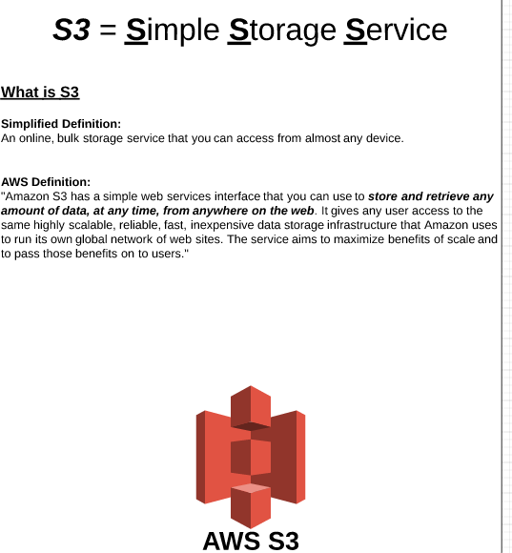
AWS – Simple Storage Service (S3)

Slide 2
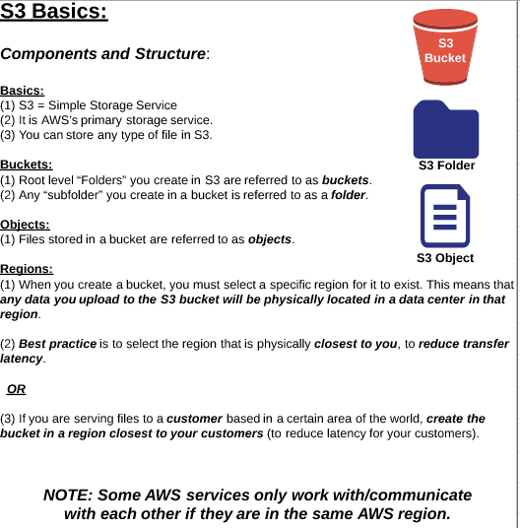
AWS – Simple Storage Service (S3)

Slide 3
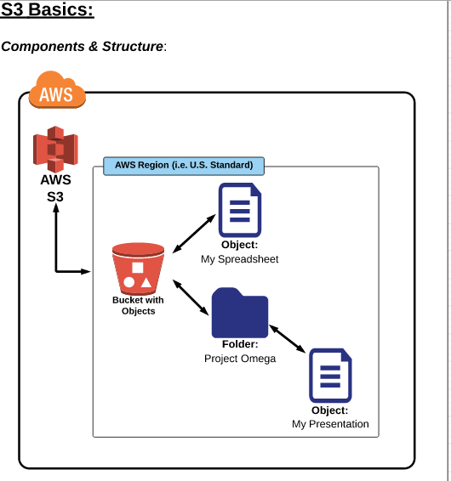
AWS – Simple Storage Service (S3)

Slide 4
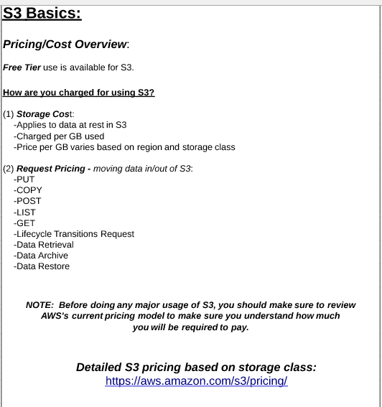
AWS – Simple Storage Service (S3)

Slide 5
AWS – Simple Storage Service (S3)

Slide 6
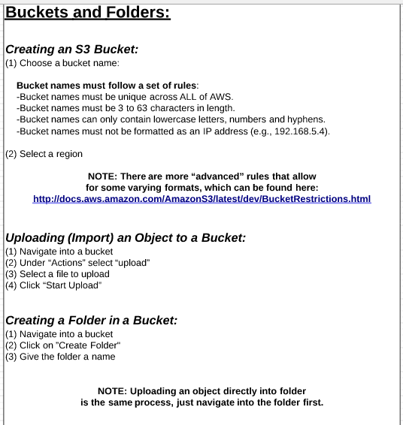
AWS – Simple Storage Service (S3)

Slide 7
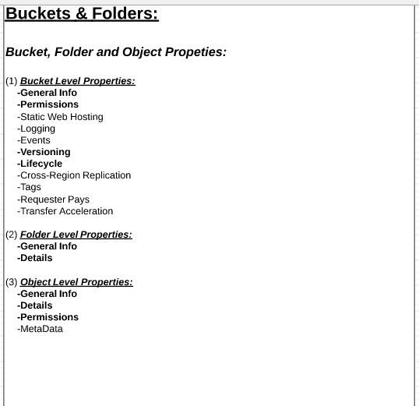
AWS – Simple Storage Service (S3)

Slide 8
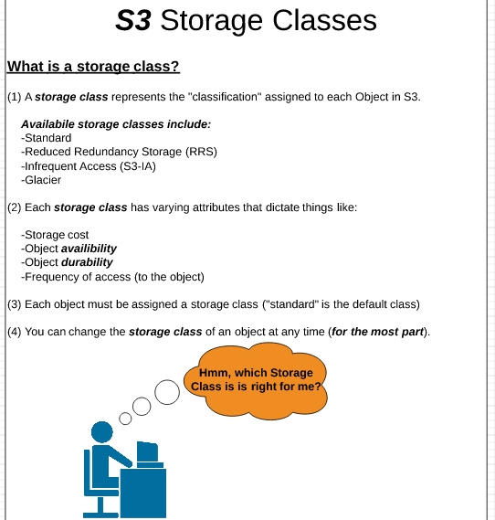
AWS – Simple Storage Service (S3)

Slide 9
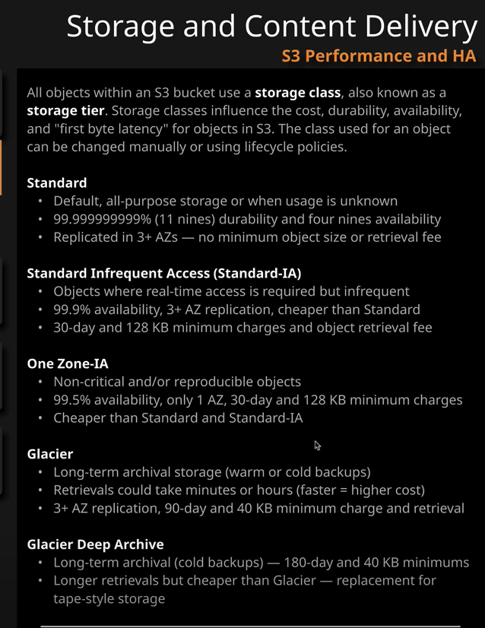
AWS – Simple Storage Service (S3)

Slide 10
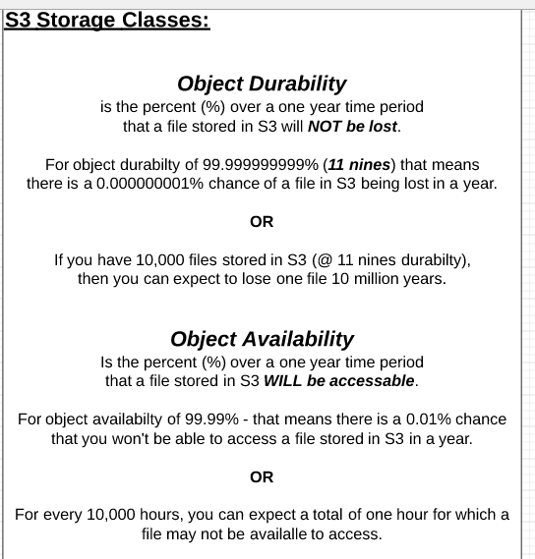
AWS – Simple Storage Service (S3)

Slide 11
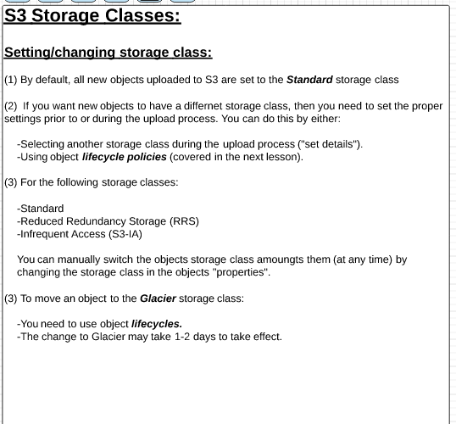
AWS – Simple Storage Service (S3)

Slide 12
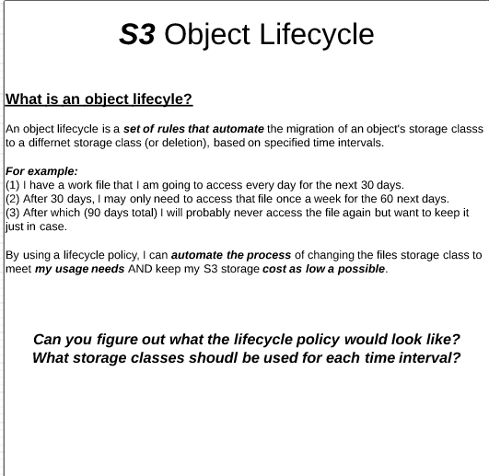
AWS – Simple Storage Service (S3)

Slide 13
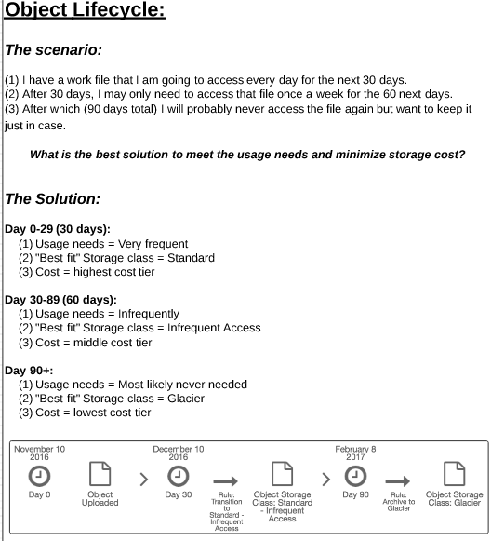
AWS – Simple Storage Service (S3)

Slide 14
AWS – Simple Storage Service (S3)

Slide 15
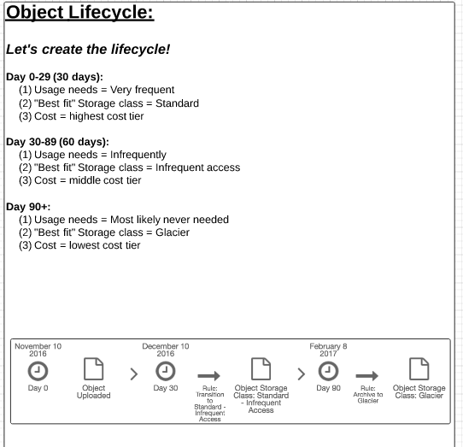
AWS – Simple Storage Service (S3)

Slide 16
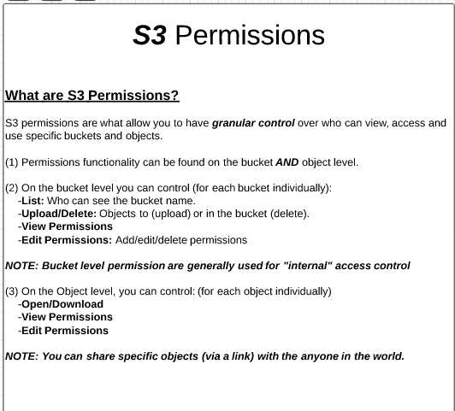
AWS – Simple Storage Service (S3)

Slide 17
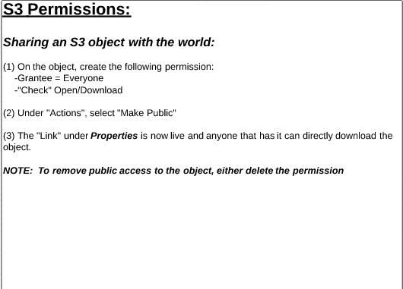
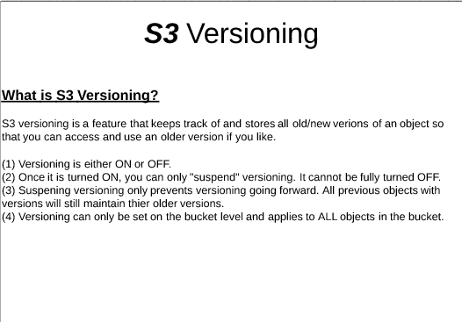
AWS – Simple Storage Service (S3)

